Slide 1
Chapter 6: Process Synchronization

Slide 2
Module 6: Process Synchronization
Background
The Critical-Section Problem
Peterson’s Solution
Synchronization Hardware
Semaphores
Classic Problems of Synchronization
Monitors
Synchronization Examples
Atomic Transactions

Slide 3
Multiple processes are running in our systems.In that case we can have two modes.
Serial and parallel.
Serial means processes will be executing one by one. Means if one process starts executing the instructions, other process will wait for the termination of the first one. Second one can not start.
Example ATM.
In Parallel systems multiple processes runs simultaneously at one time. Means next process is not waiting for the completion of the first one.
We can categorize types of processes.
Cooperating Process and Independent Process

Slide 4
Two categories of processes:-Independent and Cooperating
Independent Process:- Standalone process that does not share any data with any other process. It cannot affect or be affected by other processes executing in system.
Cooperating Process:-The process that can affect or be affected by other processes executing in the system.
They can communicate in a shared memory environment.
Share logical address space or share data through file or message.
Share code,resources like printer,CPU,Scanner
When co-operating processes concurrently share data, it may result in data inconsistency.
To maintain consistency, mechanisms are required to ensure orderly execution of co-operating processes.
Process synchronization ensures a perfect co-ordination.

Slide 5
count++ could be implemented as
register1 = count
register1 = register1 + 1
count = register1
count-- could be implemented as
register2 = count
register2 = register2 - 1
count = register2
Consider this execution interleaving with “count = 5” initially:
  S0: producer execute register1 = count {register1 = 5}
  S1: producer execute register1 = register1 + 1 {register1 = 6}
  S2: consumer execute register2 = count {register2 = 5}
  S3: consumer execute register2 = register2 - 1 {register2 = 4}
  S4: producer execute count = register1 {count = 6 }
  S5: consumer execute count = register2 {count = 4}

Slide 6
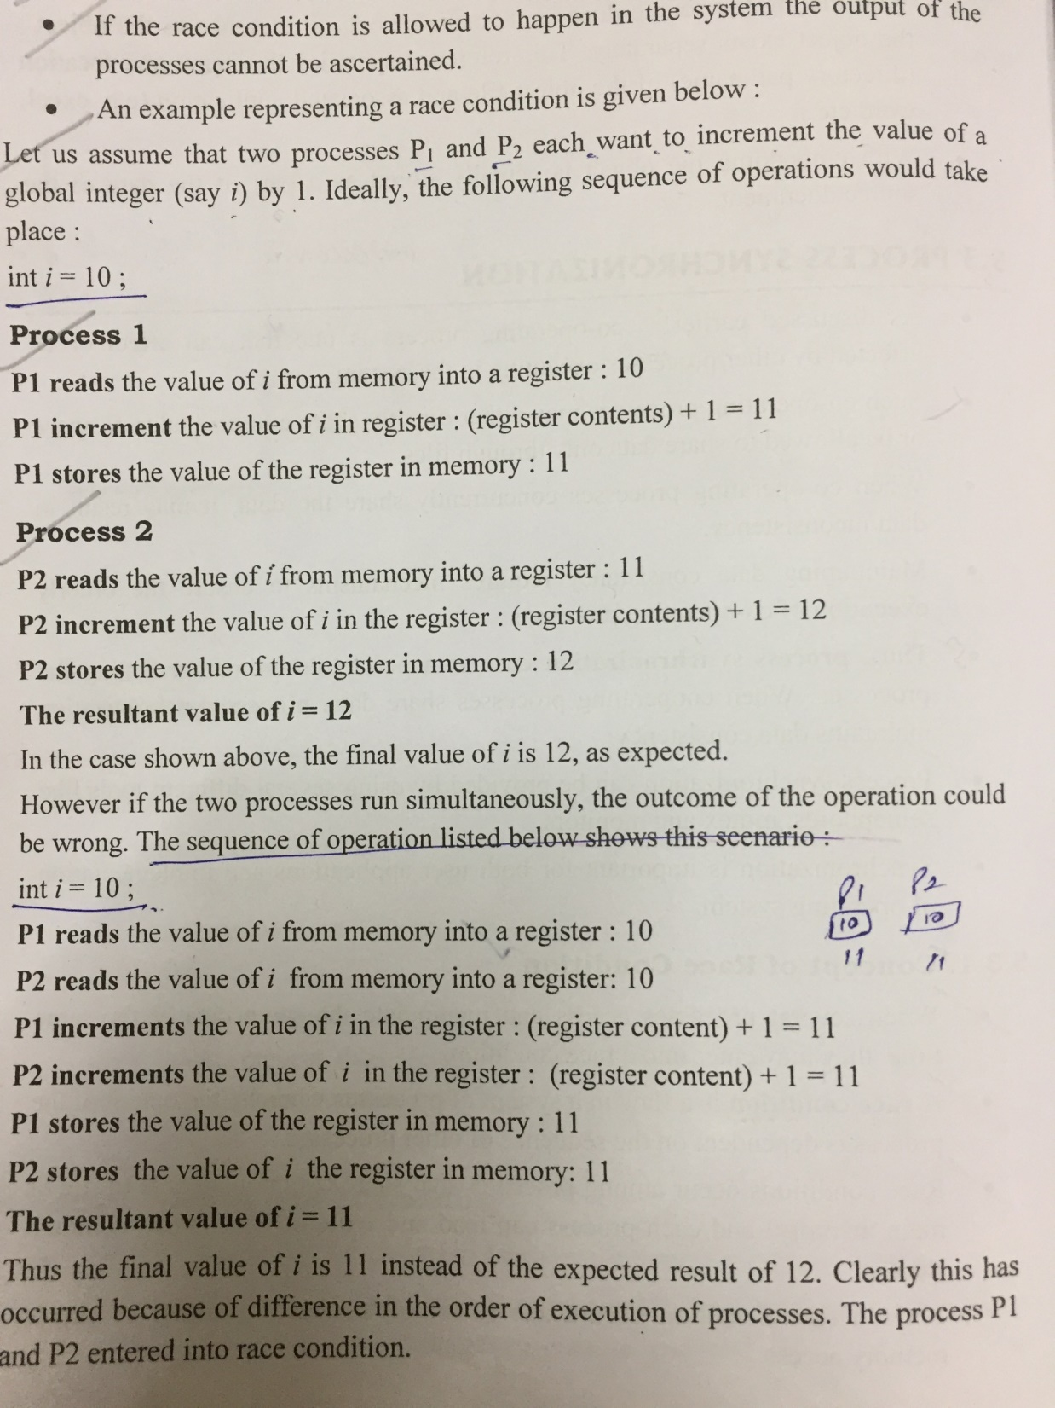

Slide 7
Background
Concurrent access to shared data may result in data inconsistency
Maintaining data consistency requires mechanisms to ensure the orderly execution of cooperating processes
Suppose that we wanted to provide a solution to the consumer-producer problem that fills all the buffers. We can do so by having an integer count that keeps track of the number of full buffers. Initially, count is set to 0. It is incremented by the producer after it produces a new buffer and is decremented by the consumer after it consumes a buffer.

Slide 8
Producer
while (true) {
/* produce an item and put in nextProduced */
while (count == BUFFER_SIZE)
; // do nothing
buffer [in] = nextProduced;
in = (in + 1) % BUFFER_SIZE;
count++;
}

Slide 9
Consumer
while (true) {
while (count == 0)
; // do nothing
nextConsumed = buffer[out];
out = (out + 1) % BUFFER_SIZE;
count--;
/* consume the item in nextConsumed
}

Slide 10
RACE CONDITION
It is the situation where several processes access and manipulate same data at the same time, they may enter into a race condition.
A race condition is FLAW in a system, where outcome of process is dependent on sequence of other processes.
A race condition occurs due to improper synchronization of shared memory access.
Example:- Two processes P1 & P2 want to increment the value of a global integer say(i) by 1.

Slide 11
Critical Section
Part of a program where shared resources are accessed by various processes(cooperative).
Critical section:-a place where something which is common is placed.
        OR
A part of program where shared resources are accessed by various processes.
Non-Critical section:-a place where something which is non-common is placed.

Slide 12
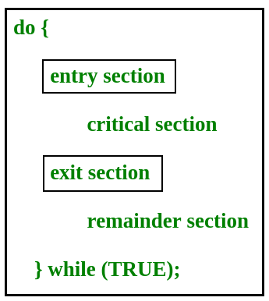

Slide 13
  ENTRY Section: request permission to enter critical section
  EXIT Section: to inform others that it has finished its critical section
  REMAINDER Section: the remaining code

Slide 14
Solution to Critical-Section Problem
A solution to the critical section problem should satisfy three requirements:
Mutual exclusion – which means that only one process will be able to enter the critical section at any time.
Progress – if some processes want to enter the critical section then at least one of them should be able to do so.
Bounded waiting – there should be a upper-bound on how long a process will have to wait for its turn to enter critical section after it has made a request to do so

Slide 15
2 Process S/w Approaches For C.S
P0
while(1)
{
while(turn!=0);
CS
turn=1;
remainder section
}
M.E is satisfied
P1
while(1)
{
while(turn!=1);
CS
turn=0;
remainder section
}
Progress is not satisfied

Slide 16
Algorithm 2
 | P0 | P1
FLAG | FALSE | FALSE
P0
while(1)
{
flag[0]=T
while(flag[1]);
CS
flag[0]=F
}
P1
while(1)
{
flag[1]=T
while(flag[0]);
CS
flag[1]=F
}
ME: YES
PROGRSS: NO

Slide 17
Peterson’s Solution
Two process solution
Assume that the LOAD and STORE instructions are atomic; that is, cannot be interrupted.
The two processes share two variables:
  int turn;
  Boolean flag[2]
The variable turn indicates whose turn it is to enter the critical section.
The flag array is used to indicate if a process is ready to enter the critical section. flag[i] = true implies that process P_{i} is ready!

Slide 18
Algorithm for two processes
Process P0
Process P1
while (true) {
flag[0] = TRUE;
turn = 1;
while (turn == 1 && flag[1]==TRUE);
CRITICAL SECTION
flag[0] = FALSE;
REMAINDER SECTION
}
while (true) {
flag[1] = TRUE;
turn = 0;
while (turn == 0 && flag[0]==TRUE);
CRITICAL SECTION
flag[1] = FALSE;
REMAINDER SECTION
}

Slide 19
Synchronization Hardware
Many systems provide hardware support for critical section code
Uniprocessors – could disable interrupts to occur
  Currently running code would execute without preemption
  Generally too inefficient on multiprocessor systems
  Disabling interrupts in multiprocessor systems can be time-consuming as the message is passed to all processors.
    Operating systems using this not broadly scalable
Modern machines provide special atomic hardware instructions
    Atomic = non-interruptable
  Either test memory word and set value
  Or swap contents of two memory words

Slide 20
TestAndndSet Instruction
Definition:
boolean TestAndSet (boolean *target)
{
boolean rv = *target;
*target = TRUE;
return rv:
}

Slide 21
Solution using TestAndSet
Shared boolean variable lock., initialized to false.
Solution:
while (true) {
while ( TestAndSet (&lock ))
; /* do nothing
// critical section
lock = FALSE;
// remainder section
}

Slide 22
Swap Instruction
Definition:
void Swap (boolean *a, boolean *b)
{
boolean temp = *a;
*a = *b;
*b = temp:
}

Slide 23
Solution using Swap
Shared Boolean variable lock initialized to FALSE; Each process has a local Boolean variable key.
Solution:
while (true) {
key = TRUE;
while ( key == TRUE)
Swap (&lock, &key );
// critical section
lock = FALSE;
// remainder section
}

Slide 24
Semaphore(S)
It gives solution to ‘n’ processes.
It is an integer variable (i.e int S;)
It is used to solve critical section problem, decides order of execution of process and resource management.
Types:-Counting semaphore and Binary semaphore.
Counting semaphore – integer value can range over an unrestricted domain
Binary semaphore – integer value can range only between 0
and 1; can be simpler to implement
  Also known as mutex locks
Can implement a counting semaphore S as a binary semaphore
Provides mutual exclusion
  Semaphore S; // initialized to 1
  wait (S);
  Critical Section
  signal (S);

Slide 25
Semaphore(S)
Two standard/atomic operations S: wait() and signal()
wait(S)/Down/P:-reduces the value of S by 1.
Signal(S)/Up/V:-increases the value of S by 1.
Initially we are setting the value of S=1 i.e. [int S=1;]
  wait (S) {
  while S <= 0; // only condition, no statement.When condition will be TRUE process will stuck in TRAP
  // CS
  S--;
  }
  signal (S) {
  S++;
  }

Slide 26
Counting Semaphore
Down(semaphore S)
{
S.value=S.value-1;
If (S.value<0)
{
put process in suspend list,
sleep();
}
Else
Return (CS);
}
Up(semaphore S)
{
S.value=S.value+1;
If (S.value<=0)
{
select process from suspend list, wake up();
}
}

Slide 27
Binary Semaphore
Down(semaphore S)
{
If (S.value==1)
{
S.value = 0;
}
Else
{
put process in suspend list,
sleep();
}
}
Up(semaphore S)
{
If (suspend list is empty)
{
S.value=1;
}else
{
select process from suspend list, wake up();
}
}

Slide 28
Semaphore Implementation
Must guarantee that no two processes can execute wait () and signal () on the same semaphore at the same time
Thus, implementation becomes the critical section problem where the wait and signal code are placed in the crtical section.
  Could now have busy waiting in critical section implementation
    But implementation code is short
    Little busy waiting if critical section rarely occupied
Note that applications may spend lots of time in critical sections and therefore this is not a good solution.

Slide 29
Semaphore Implementation with no Busy waiting
With each semaphore there is an associated waiting queue. Each entry in a waiting queue has two data items:
  value (of type integer)
  pointer to next record in the list
Two operations:
  block – place the process invoking the operation on the appropriate waiting queue.
  wakeup – remove one of processes in the waiting queue and place it in the ready queue.

Slide 30
Semaphore Implementation with no Busy waiting (Cont.)
Implementation of wait:
wait (S){
value--;
if (value < 0) {
add this process to waiting queue
block(); }
}
Implementation of signal:
Signal (S){
value++;
if (value <= 0) {
remove a process P from the waiting queue
wakeup(P); }
}

Slide 31
Deadlock and Starvation
Deadlock – two or more processes are waiting indefinitely for an event that can be caused by only one of the waiting processes
Let S and Q be two semaphores initialized to 1
P₀ P₁
wait (S); wait (Q);
wait (Q); wait (S);
. .
. .
. .
signal (S); signal (Q);
signal (Q); signal (S);
Starvation – indefinite blocking. A process may never be removed from the semaphore queue in which it is suspended.

Slide 32
Classical Problems of Synchronization
Bounded-Buffer Problem
Readers and Writers Problem
Dining-Philosophers Problem

Slide 33
Bounded-Buffer Problem
N buffers, each can hold one item
Semaphore mutex initialized to the value 1
Semaphore full initialized to the value 0
Semaphore empty initialized to the value N.

Slide 34
Bounded Buffer Problem (Cont.)
The structure of the producer process
while (true) {
// produce an item
wait (empty);
wait (mutex);
// add the item to the buffer
signal (mutex);
signal (full);
}

Slide 35
Bounded Buffer Problem (Cont.)
The structure of the consumer process
while (true) {
wait (full);
wait (mutex);
// remove an item from buffer
signal (mutex);
signal (empty);
// consume the removed item
}

Slide 36
Readers-Writers Problem
A data set is shared among a number of concurrent processes
  Readers – only read the data set; they do not perform any updates
  Writers – can both read and write.
Problem – allow multiple readers to read at the same time. Only one single writer can access the shared data at the same time.
Shared Data
  Data set
  Semaphore mutex initialized to 1.
  Semaphore wrt initialized to 1.
  Integer readcount initialized to 0.

Slide 37
Readers-Writers Problem (Cont.)
The structure of a writer process
while (true) {
wait (wrt) ;
// writing is performed
signal (wrt) ;
}

Slide 38
Readers-Writers Problem (Cont.)
The structure of a reader process
while (true) {
wait (mutex) ;
readcount ++ ;
if (readcount == 1) wait (wrt) ;
signal (mutex)
// reading is performed
wait (mutex) ;
readcount - - ;
if (readcount == 0) signal (wrt) ;
signal (mutex) ;
}

Slide 39
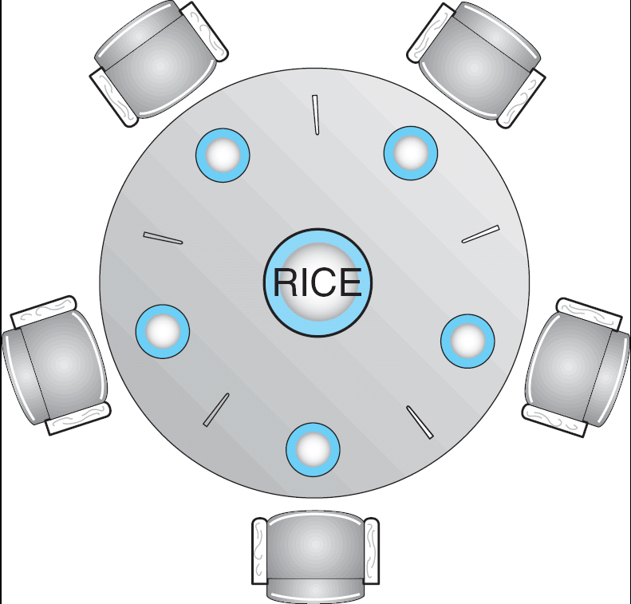
Dining-Philosophers Problem
Shared data
  Bowl of rice (data set)
  Semaphore chopstick/forks [5] initialized to 1

Slide 40
while (true)
{
THINKING();
take_fork (i); //left fork
take_fork( (i+1)%N) //right fork, N – No. of forks
EAT();
put_fork (i);
put_fork( (i+1)%N)
}

Slide 41
while (true)
{
THINKING();
wait(take_fork (i)); //left fork
wait(take_fork( (i+1)%N) )//right fork, N –No. of forks
EAT();
signal(put_fork (i));
signal(put_fork( (i+1)%N))
}
S[i]=5(semaphores)
All are initialized to 1
Each process uses two forks, so no. of semaphores required are two
P0: S0 S1
P1: S1 S2
P2: S2 S3
P3: S3 S4
P4: S4 S0

Slide 42
Dining-Philosophers Problem (Cont.)
The structure of Philosopher i:
    While (true) {
    wait ( chopstick[i] );
    wait ( chopStick[ (i + 1) % 5] );
    // eat
    signal ( chopstick[i] );
    signal (chopstick[ (i + 1) % 5] );
    // think
    }

Slide 43
Problems with Semaphores
Incorrect use of semaphore operations:
  signal (mutex) …. wait (mutex)
  wait (mutex) … wait (mutex)
  Omitting of wait (mutex) or signal (mutex) (or both)

Slide 44
Monitors
A software module consisting of one or more procedures, an initialization sequence and local data.
A high-level abstraction that provides a convenient and effective mechanism for process synchronization
Same as a class type: objects, methods, variables.
Only one process may be active within the monitor at a time
    monitor monitor-name
    {
    // shared variable declarations
    procedure P1 (…) { …. }
    …
    procedure Pn (…) {……}
    Initialization code ( ….) { … }
    …
    }
    }

Slide 45
Monitor Rules
Any process can access any monitor procedure at any time
Only one process may enter a monitor procedure
No process may directly access a monitor’s local variables
A monitor may only access it’s local variables

Slide 46

Schematic view of a Monitor

Slide 47
Condition Variables
condition x, y;(for achieving synchronization, contained and accessed within monitor only)
  Something to store who’s waiting for a particular reason
  Implemented as a queue
Two operations on a condition variable:
  x.wait () – a process that invokes the operation is
  suspended.” Forces running process to sleep
  ”
  x.signal () – resumes one of processes (if any) that
  invoked x.wait () “Wakes up a sleeping process”

Slide 48

Monitor with Condition Variables

Slide 49
In addition to thinking and eating, a philosopher has one more state, hungry, in which he is trying to get chops.
We use an array state[] to keep track the state of a philosopher. Thus, philosopher i can eat (i.e.,state[i] = EATING) only if his neighbors are
not eating (i.e., state[(i+4)%5] and
state[(i+1)%5] are not EATING).

Slide 50
Solution to Dining Philosophers
monitor DP
{
enum ( THINKING; HUNGRY, EATING) state [5] ;
condition self [5];
void pickup (int i) {
state[i] = HUNGRY;
test(i);
if (state[i] != EATING) self [i].wait;
}
void putdown (int i) {
state[i] = THINKING;
// test left and right neighbors
test((i + 4) % 5);
test((i + 1) % 5);
}

Slide 51
Solution to Dining Philosophers (cont)
void test (int i) {
if ( (state[(i + 4) % 5] != EATING) &&
(state[i] == HUNGRY) &&
(state[(i + 1) % 5] != EATING) ) {
state[i] = EATING ;
self[i].signal () ; //wakes up the process
}
}
initialization_code() {
for (int i = 0; i < 5; i++)
state[i] = THINKING;
}
}

Slide 52
Solution to Dining Philosophers (cont)
Each philosopher I invokes the operations pickup()
and putdown() in the following sequence:
dp.pickup (i)
EAT
dp.putdown (i)

Slide 53
Monitor Implementation Using Semaphores
Variables
semaphore mutex; // (initially = 1)
semaphore next; // (initially = 0)
int next-count = 0;
Each procedure F will be replaced by
wait(mutex);
…
body of F;
…
if (next-count > 0)
signal(next)
else
signal(mutex);
Mutual exclusion within a monitor is ensured.

Slide 54
Monitor Implementation
For each condition variable x, we have:
semaphore x-sem; // (initially = 0)
int x-count = 0;
The operation x.wait can be implemented as:
x-count++;
if (next-count > 0)
signal(next);
else
signal(mutex);
wait(x-sem);
x-count--;

Slide 55
Monitor Implementation
The operation x.signal can be implemented as:
if (x-count > 0) {
next-count++;
signal(x-sem);
wait(next);
next-count--;
}

Slide 56
Synchronization Examples
Solaris
Windows XP
Linux
Pthreads

Slide 57
Solaris Synchronization
Implements a variety of locks to support multitasking, multithreading (including real-time threads), and multiprocessing
Uses adaptive mutexes for efficiency when protecting data from short code segments
Uses condition variables and readers-writers locks when longer sections of code need access to data
Uses turnstiles to order the list of threads waiting to acquire either an adaptive mutex or reader-writer lock

Slide 58
Windows XP Synchronization
Uses interrupt masks to protect access to global resources on uniprocessor systems
Uses spinlocks on multiprocessor systems
Also provides dispatcher objects which may act as either mutexes and semaphores
Dispatcher objects may also provide events
  An event acts much like a condition variable

Slide 59
Linux Synchronization
Linux:
  disables interrupts to implement short critical sections
Linux provides:
  semaphores
  spin locks

Slide 60
Pthreads Synchronization
Pthreads API is OS-independent
It provides:
  mutex locks
  condition variables
Non-portable extensions include:
  read-write locks
  spin locks

Slide 61
Atomic Transactions
System Model
Log-based Recovery
Checkpoints
Concurrent Atomic Transactions

Slide 62
System Model
Assures that operations happen as a single logical unit of work, in its entirety, or not at all
Related to field of database systems
Challenge is assuring atomicity despite computer system failures
Transaction - collection of instructions or operations that performs single logical function
  Here we are concerned with changes to stable storage – disk
  Transaction is series of read and write operations
  Terminated by commit (transaction successful) or abort (transaction failed) operation
  Aborted transaction must be rolled back to undo any changes it performed

Slide 63
Types of Storage Media
Volatile storage – information stored here does not survive system crashes
  Example: main memory, cache
Nonvolatile storage – Information usually survives crashes
  Example: disk and tape
Stable storage – Information never lost
  Not actually possible, so approximated via replication or RAID to devices with independent failure modes
Goal is to assure transaction atomicity where failures cause loss of information on volatile storage

Slide 64
Log-Based Recovery
Record to stable storage information about all modifications by a transaction
Most common is write-ahead logging
  Log on stable storage, each log record describes single transaction write operation, including
    Transaction name
    Data item name
    Old value
    New value
  <T_{i} starts> written to log when transaction T_{i} starts
  <T_{i} commits> written when T_{i} commits
Log entry must reach stable storage before operation on data occurs

Slide 65
Log-Based Recovery Algorithm
Using the log, system can handle any volatile memory errors
  Undo(T_{i}) restores value of all data updated by T_{i}
  Redo(T_{i}) sets values of all data in transaction T_{i} to new values
Undo(T_{i}) and redo(T_{i}) must be idempotent
  Multiple executions must have the same result as one execution
If system fails, restore state of all updated data via log
  If log contains <T_{i} starts> without <T_{i} commits>, undo(T_{i})
  If log contains <T_{i} starts> and <T_{i} commits>, redo(T_{i})

Slide 66
Checkpoints
Log could become long, and recovery could take long
Checkpoints shorten log and recovery time.
Checkpoint scheme:
  Output all log records currently in volatile storage to stable storage
  Output all modified data from volatile to stable storage
  Output a log record <checkpoint> to the log on stable storage
Now recovery only includes Ti, such that Ti started executing before the most recent checkpoint, and all transactions after Ti All other transactions already on stable storage

Slide 67
Concurrent Transactions
Must be equivalent to serial execution – serializability
Could perform all transactions in critical section
  Inefficient, too restrictive
Concurrency-control algorithms provide serializability

Slide 68
Serializability
Consider two data items A and B
Consider Transactions T₀ and T₁
Execute T₀, T₁ atomically
Execution sequence called schedule
Atomically executed transaction order called serial schedule
For N transactions, there are N! valid serial schedules

Slide 69

Schedule 1: T₀ then T₁

Slide 70
Nonserial Schedule
Nonserial schedule allows overlapped execute
  Resulting execution not necessarily incorrect
Consider schedule S, operations O_{i}, O_{j}
  Conflict if access same data item, with at least one write
If O_{i}, O_{j} consecutive and operations of different transactions & O_{i} and O_{j} don’t conflict
  Then S’ with swapped order O_{j} O_{i} equivalent to S
If S can become S’ via swapping nonconflicting operations
  S is conflict serializable

Slide 71

Schedule 2: Concurrent Serializable Schedule

Slide 72
Locking Protocol
Ensure serializability by associating lock with each data item
  Follow locking protocol for access control
Locks
  Shared – T_{i} has shared-mode lock (S) on item Q, T_{i} can read Q but not write Q
  Exclusive – Ti has exclusive-mode lock (X) on Q, T_{i} can read and write Q
Require every transaction on item Q acquire appropriate lock
If lock already held, new request may have to wait
  Similar to readers-writers algorithm

Slide 73
Two-phase Locking Protocol
Generally ensures conflict serializability
Each transaction issues lock and unlock requests in two phases
  Growing – obtaining locks
  Shrinking – releasing locks
Does not prevent deadlock

Slide 74
Timestamp-based Protocols
Select order among transactions in advance – timestamp-ordering
Transaction T_{i} associated with timestamp TS(T_{i}) before T_{i} starts
  TS(T_{i}) < TS(T_{j}) if Ti entered system before T_{j}
  TS can be generated from system clock or as logical counter incremented at each entry of transaction
Timestamps determine serializability order
  If TS(T_{i}) < TS(T_{j}), system must ensure produced schedule equivalent to serial schedule where T_{i} appears before T_{j}

Slide 75
Timestamp-based Protocol Implementation
Data item Q gets two timestamps
  W-timestamp(Q) – largest timestamp of any transaction that executed write(Q) successfully
  R-timestamp(Q) – largest timestamp of successful read(Q)
  Updated whenever read(Q) or write(Q) executed
Timestamp-ordering protocol assures any conflicting read and write executed in timestamp order
Suppose Ti executes read(Q)
  If TS(T_{i}) < W-timestamp(Q), Ti needs to read value of Q that was already overwritten
    read operation rejected and T_{i} rolled back
  If TS(T_{i}) ≥ W-timestamp(Q)
    read executed, R-timestamp(Q) set to max(R-timestamp(Q), TS(T_{i}))

Slide 76
Timestamp-ordering Protocol
Suppose Ti executes write(Q)
  If TS(T_{i}) < R-timestamp(Q), value Q produced by T_{i} was needed previously and T_{i} assumed it would never be produced
    Write operation rejected, T_{i} rolled back
  If TS(T_{i}) < W-tiimestamp(Q), T_{i} attempting to write obsolete value of Q
    Write operation rejected and T_{i} rolled back
  Otherwise, write executed
Any rolled back transaction T_{i} is assigned new timestamp and restarted
Algorithm ensures conflict serializability and freedom from deadlock

Slide 77

Schedule Possible Under Timestamp Protocol

Slide 78
End of Chapter 6

